Slide 1


5005CEM Lecture 2b: Data Visualisation
School of Computing, Mathematics and Data Science Coventry University
5005CEM Data Science 2022/23 Semester 2

Slide 2

Exploratory Data Analysis (EDA)
Summarise the main characteristics of a dataset (both visually and using summary statistics)
Aim to discover patterns and propose hypotheses/models.
Ask the question: “What is going on here?”
Established by John Tukey (1915–2000) in his book Exploratory Data Analysis (1977).
Also invented the boxplot and terms “bit” and “software”.
Notes:
Reading: http://cll.stanford.edu/~langley/cogsys/behrens97pm.pdf

Slide 3

What is Exploratory Data Analysis?
Tukey often related EDA to detective work (collecting evidence and clues related to the central question in the case).
Role of the data scientist is to “listen” to the data in as many ways as possible until a plausible “story” of the data is apparent.
Notes:
Image from:
Reading: http://creative-wisdom.com/teaching/WBI/EDA.shtml

Slide 4
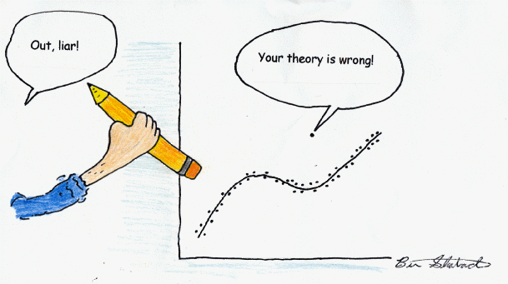
Why Data Visualisation?
To explore data and reveal:
Errors and anomalies
Relationship between variables
Structure
Complexity
Patterns
Clusters
Anything we can’t easily discover in other ways
Notes:
Image from: http://davidmlane.com/ben/outlier.gif

Slide 5
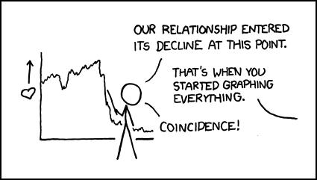
Why Data Visualisation?
To communicate
Present information concisely
Simplify complex ideas
Tell a story
Explain conclusions
Convey a message
Where is the dividing line between objective presentation of information and manipulation of your audience (propaganda)?
Notes:
Image from: https://xkcd.com/523/

Slide 6
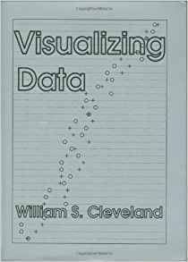
History of Data Visualisation
Started with simple cave drawings depicting the success of a hunt.
Prior to 1600, data visualisation existed mainly in the realm of maps.
William Cleveland’s book Visualizing Data (1993).
Modern dashboards connect to millions of rows of data.
Notes:
Reading: https://archive.org/details/visualizingdata00will/
Reading: https://www.dundas.com/resources/dundas-data-visualization-blog/brief-history-data-visualization
Reading: http://euclid.psych.yorku.ca/datavis.ca/papers/gfkl.pdf

Slide 7
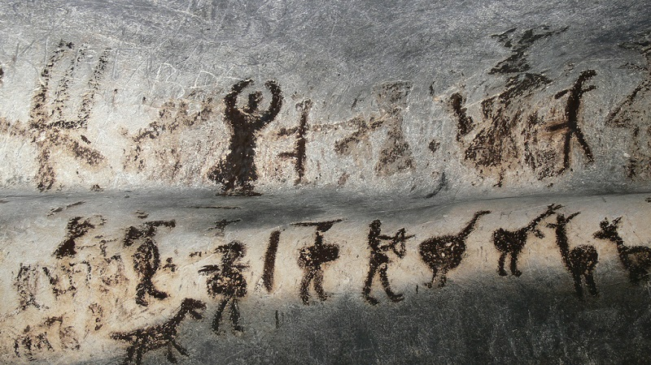
Magura Cave (Bulgaria)
6300BC–3000BC
Notes:
Image and reading: https://en.wikipedia.org/wiki/Magura_Cave

Slide 8
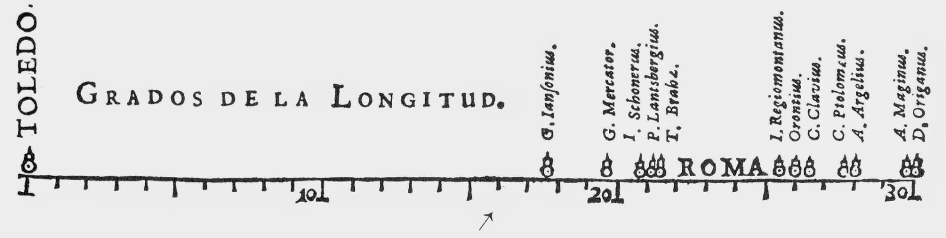
Michael van Langren (1598–1675)
Flemish astronomer, first known visual representation of statistical data (1644).
Spread of estimates of distance (in degrees longitude) between Toledo and Rome.
Notes:
Journal paper: https://doi.org/10.1198/tast.2010.09154

Slide 9
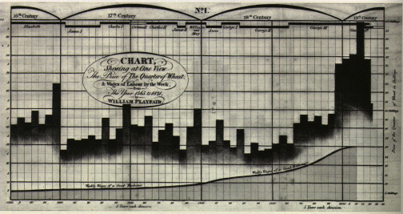
William Playfair (1759–1823)
Inventor of the line, area and bar charts (1786) and pie chart (1801).
Example: bar chart (1821) of price of wheat, weekly wages and reigning monarch over 1565–1820.

Slide 10
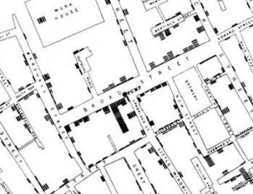
John Snow (1813–1858)
Cholera outbreaks in London (1854).
Studied the pattern of outbreak locations to identify the source as a public water pump on Broad Street (later found to be taking water from sewage-polluted sections of the Thames river).
Notes:
Reading: http://www.bbc.co.uk/history/historic_figures/snow_john.shtml

Slide 11
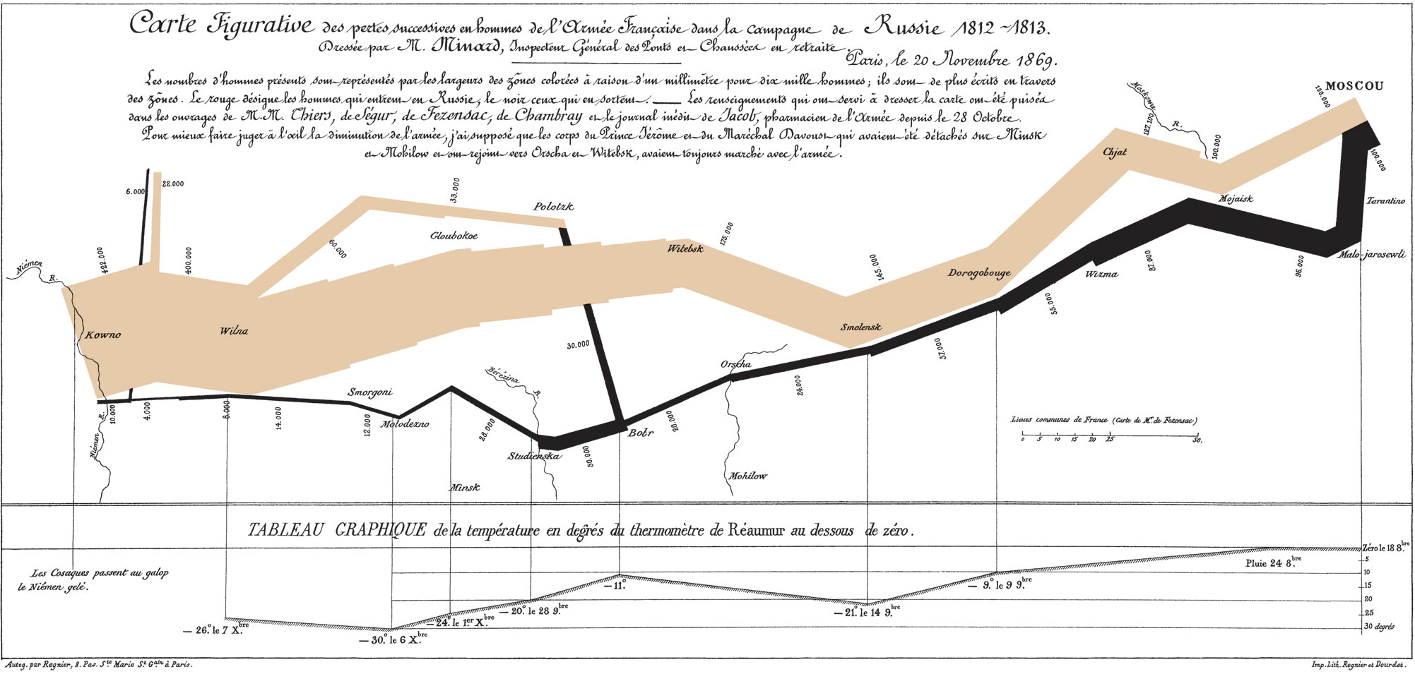
Charles Minard (1781–1870)
Napoleon’s Russian campaign of 1812 (“flow” of troops).
Notes:
Image from: https://en.wikipedia.org/wiki/Charles_Joseph_Minard
Displays six types of data in two dimensions: the number of Napoleon's troops; the distance traveled; temperature; latitude and longitude; direction of travel; and location relative to specific dates.

Slide 12
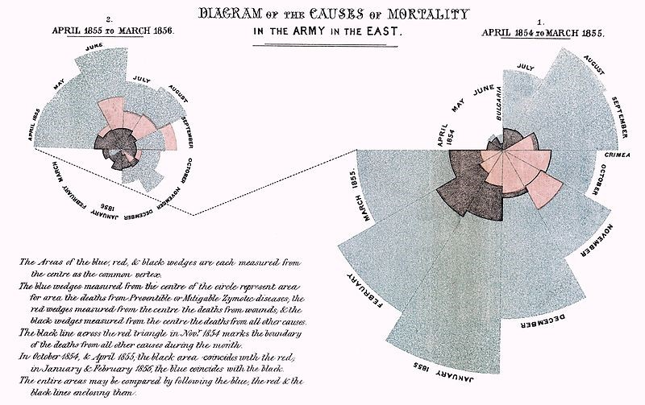
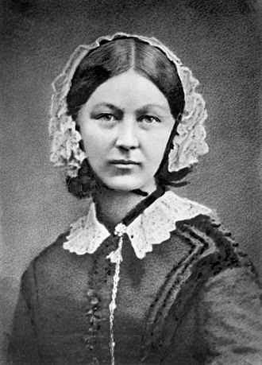
Florence Nightingale (1820–1910)
Crimean War (1853–56)
The “Lady with the Lamp”.
Nightingale rose or Coxcomb chart (polar area plot).
Notes:
Reading: https://en.wikipedia.org/wiki/Florence_Nightingale#Statistics_and_sanitary_reform
See also: https://datavizcatalogue.com/methods/nightingale_rose_chart.html

Slide 13
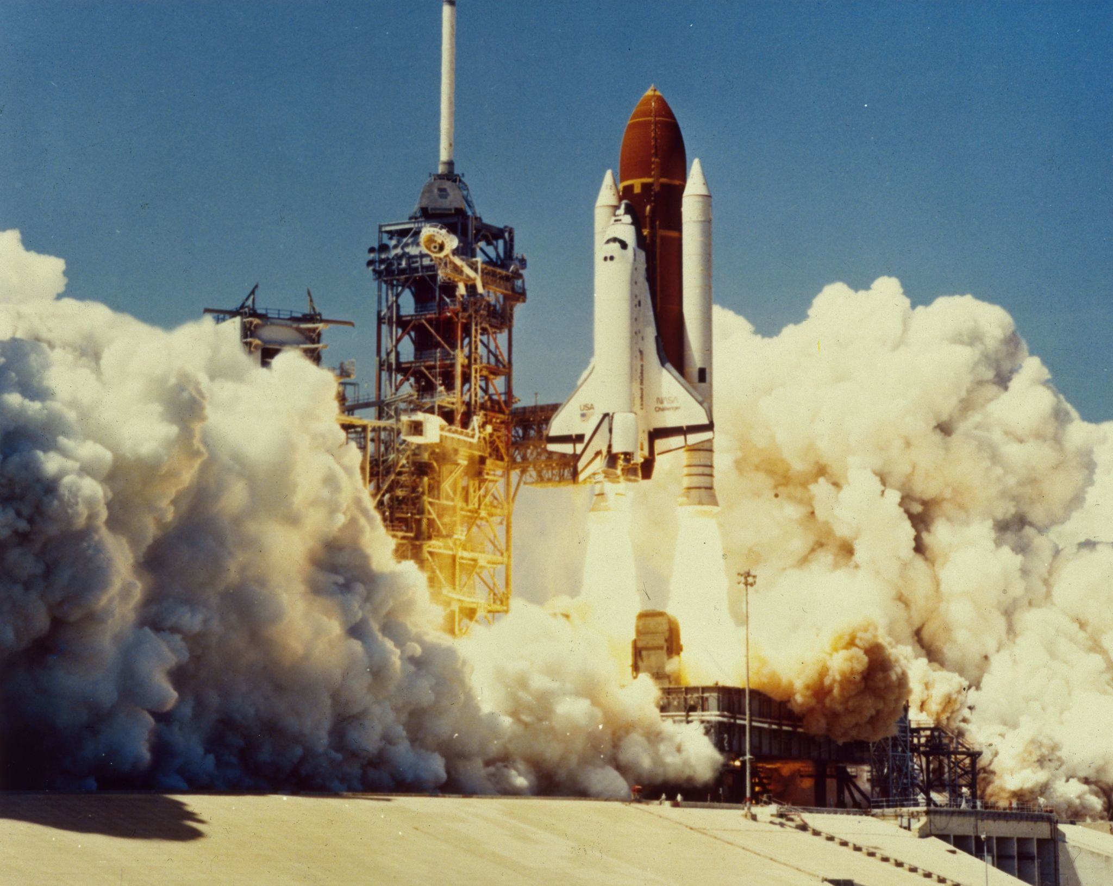
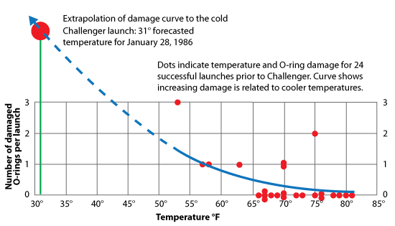

Space Shuttle Challenger Disaster (1986)
28 January 1986: temperatures close to -1$℃$ (30$℉$).
No test data to support successful launch (extrapolation).
Notes:
Graph from: https://www.workshopdigital.com/blog/youre-probably-using-wrong-graph/
Youtube: https://www.youtube.com/watch?v=yibNEcn-4yQ

Slide 14
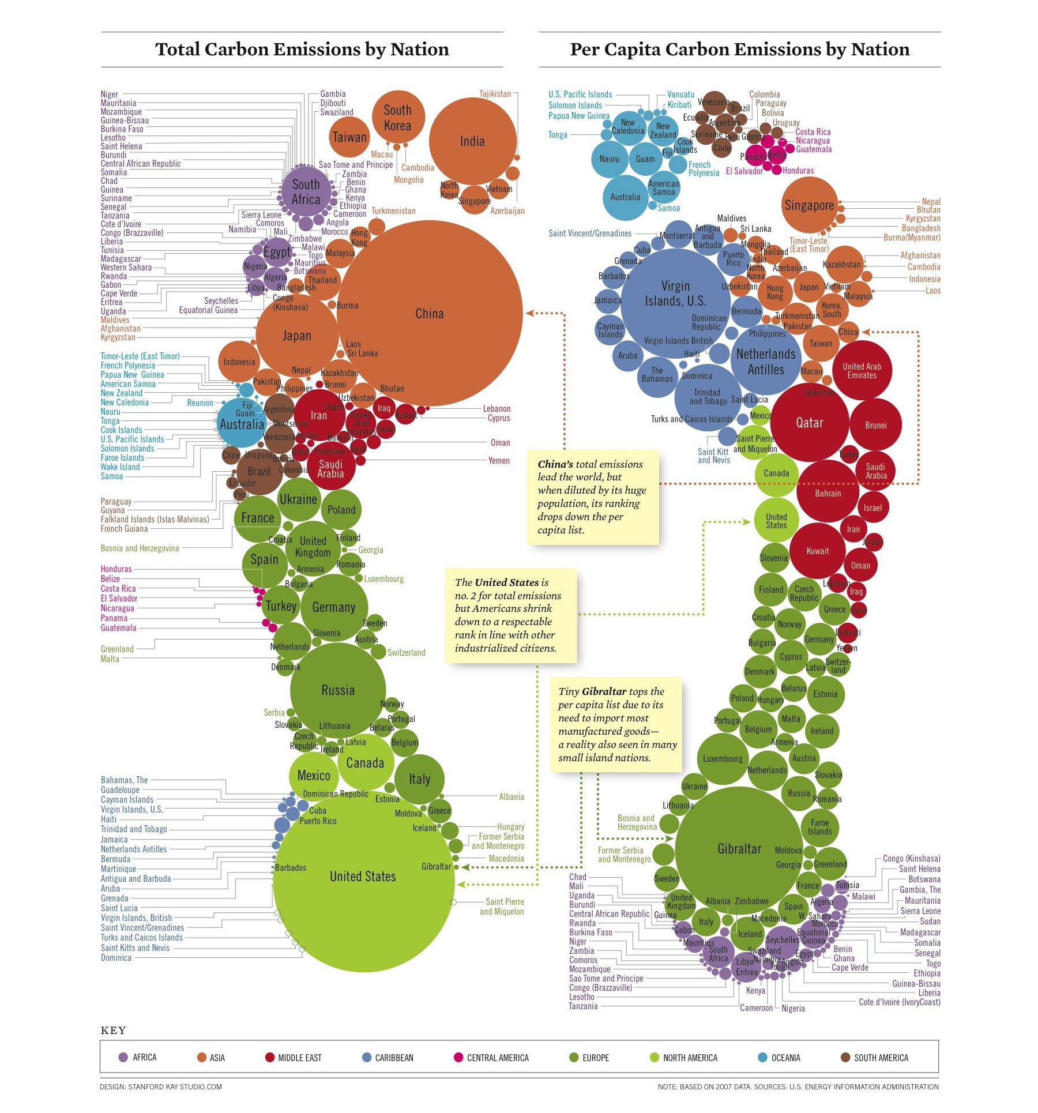
Carbon Footprint of Nations (2010)
Infographic by Stanford Kay
Colours indicate continent
Notes:
Source: https://philebersole.wordpress.com/2011/11/25/the-carbon-footprints-of-nations/

Slide 15
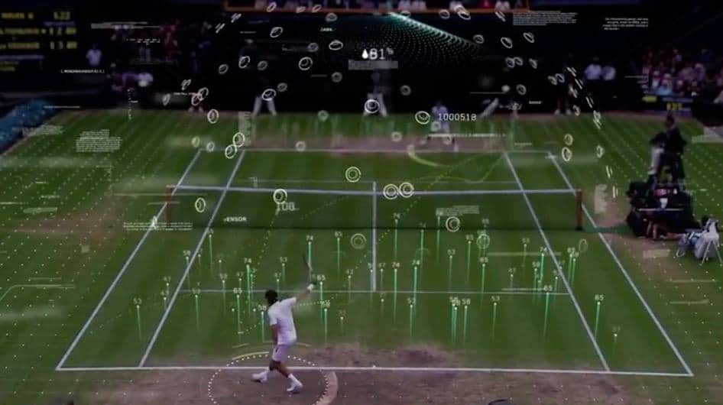
Data Visualisation in Live Sport
Wimbledon Tennis tournament (2018)
Partnership with IBM
Notes:
Youtube: https://www.youtube.com/watch?v=J6uKtMAMkhY
Image from: https://dreamsports.tv/wimbledon-flashes-big-data-visualisation-live/

Slide 16
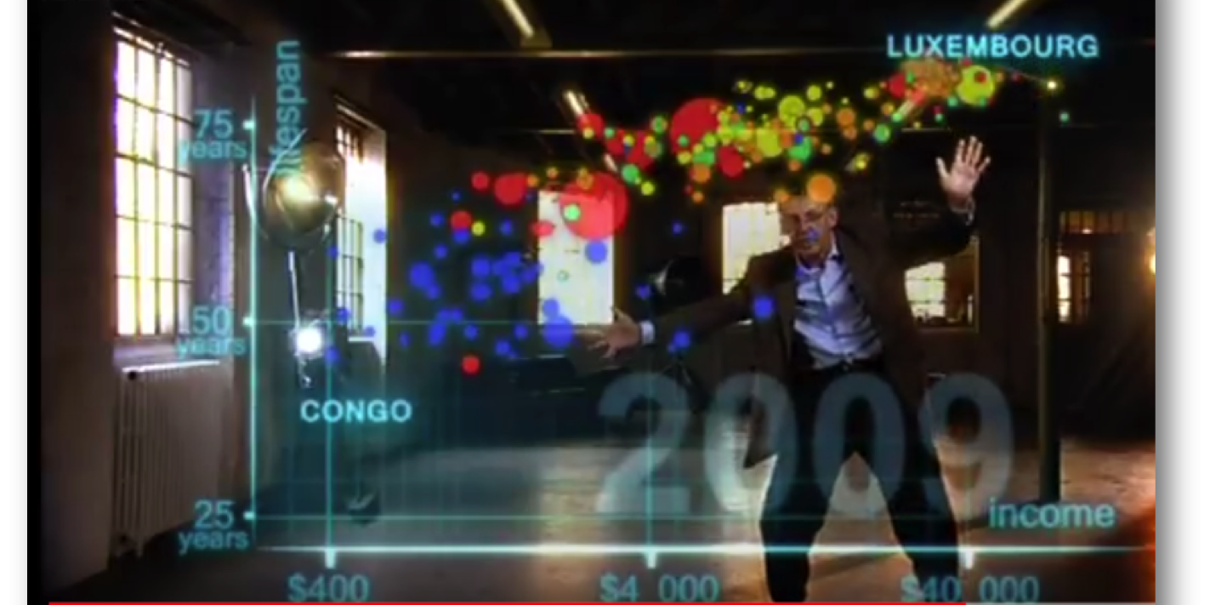
Prof Hans Rosling (1948–2017)
200 countries, 200 years, in four minutes: Joy of Stats
Notes:
Website: https://www.gapminder.org/tools/
Youtube: https://www.youtube.com/watch?v=ahp7QhbB8G4

Slide 17
Class Discussion Question
Consider the video "200 Countries, 200 years, in four minutes: Joy of Stats" by Prof Hans Rosling
What impresses you about the presentation?
Is there anything that concerns you about this presentation?
Is exploration different from presentation?

Slide 18
Exploration vs Presentation
Data can bring surprises
Data may have outliers
Data moves unpredictably
Viewer controls interaction
Analyse multiple dimensions
Change mappings often
Look for trends and holes
Data well-known to the presenter
Data has been scrubbed
Viewer is passive
Present few dimensions to make a point
Highlight critical points
Group points to show trends and motion
Notes:
Reading: http://www.audentia-gestion.fr/MICROSOFT/bv_ch19.pdf

Slide 19
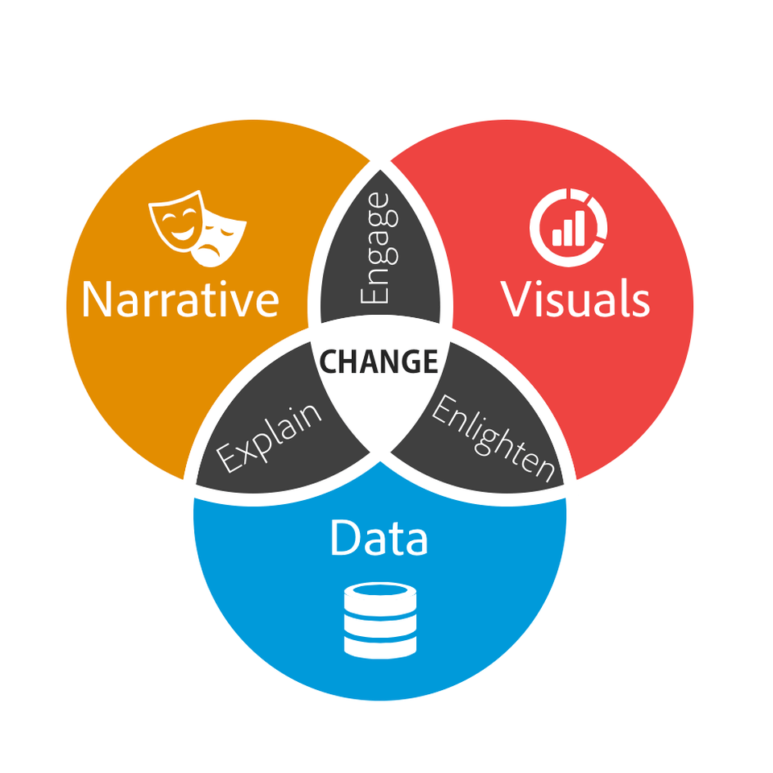
Data Storytelling
“The human mind is a story processor, not a logic processor.” — Jonathan Haidt
Check your data is accurate and can be trusted
Check for biases and faulty reasoning
Start with data, not with narrative
“Verifying a hypothesis or a hunch with data is different that cherry-picking facts to justify a decision or support an agenda.”
Notes:
Article and Image: https://www.blastanalytics.com/blog/why-data-storytelling-essential-data-science-skill
Quote: https://blogs.scientificamerican.com/guest-blog/it-is-in-our-nature-to-need-stories/

Slide 20
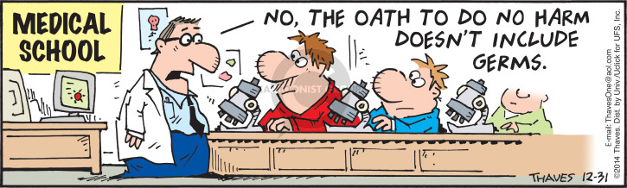
“First, do no harm”
Hippocratic oath (medical professionals)
Responsibility and neutrality
Transparency and honesty
Equity (no illegal or illegitimate discrimination)
Notes:
Reading: https://towardsdatascience.com/hippocratic-oath-for-data-scientists-407d2db15a78
Reading: https://www.theguardian.com/science/2019/aug/16/mathematicians-need-doctor-style-hippocratic-oath-says-academic-hannah-fry
Image: https://www.thecomicstrips.com/subject/The-Hippocratic+Oath-Comic-Strips.php

Slide 21
Bias (garbage in, garbage out)
Data is not neutral (data is biased)
There is no such thing as raw data (need auditable history)
Algorithmic reinforcement of human biases
Under-representation of parts of the population in data
Example: race bias in facial recognition
Example: Microsoft's twitter bot "Tay“
Example: Amazon applicant selection bias against women
Notes:
Reading: https://towardsdatascience.com/bias-what-it-means-in-the-big-data-world-6e64893e92a1

Slide 22
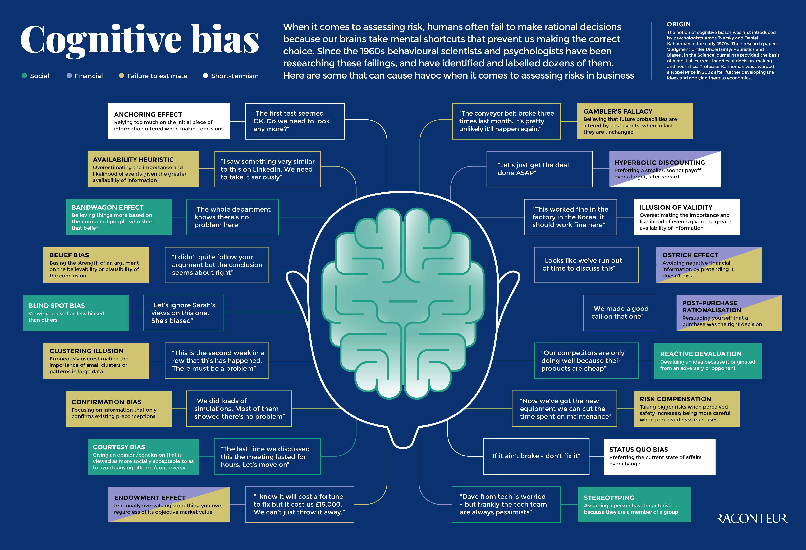
Notes:
Image: https://www.raconteur.net/infographics/cognitive-bias/
Reading: https://cmotions.nl/en/5-typen-bias-data-analytics/

Slide 23
Data Ethics
What is legal (allowed by law, compliant with regulation)
What is ethical (right, fair, just, risk of negative impact)
Legal
Ethical
Notes:
Reading: https://www.gov.uk/government/publications/data-ethics-framework/data-ethics-framework-2020

Slide 24
Summary
Exploratory Data Analysis (EDA) – detective work
Exploration vs presentation
Data visualisation vs data “story telling”
Data storytelling and the Hippocratic oath
Bias (garbage in, garbage out).
Need for Data Ethics
Legal
Ethical

